Slide 1
INTERMEDIATE PROGRAMMING LESSON
Data Wires

Slide 2
Lesson Objectives
Learn what Data Wires are and how to use them
Prerequisites: Display Block, Sensor Block, Brick Buttons

Slide 3
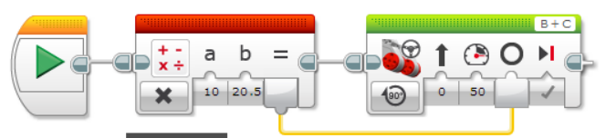
Data Wires
A Data Wire allows you to take an output from one programming block and input it into another.
Output
Input

Slide 4
Data Wire Types
Data Type | Input | Output | Output Data Wire
Logic |  | True or False
Numeric |  | Number
Text |  | Text
Numeric Array
Logic Array
Images from EV3 Help

Slide 5
Automatic Data Wire Conversions
From Data Type | To Data Type | Output/Result
Logic | Numeric | False = 0, True = 1
Logic | Text | False = “0”, True = “1”
Logic | Logic Array | Array with one element
Logic | Numeric Array | Array with one element (0 or 1)
Numeric | Text | Text that represents a number
Numeric | Numeric Array | Array with one element
Logic Array | Numeric Array | Same size array with all elements equal to 0 or 1
These conversions are automatically performed in the programming blocks. For example, you are allowed to connect a numeric value (like what color a sensor sees) to a text value (on a display block).
Content from EV3 Help

Slide 6
How to Create a Data Wire
The block with the output must be placed before the block with the input
The input and the output must be the same data type or onoe that can be automatically converted (see slides 4 and 5)
1. Click on the output on the block
2. Hold and drag the wire.
3. Move the icon into the correct input and then let go of the mouse
1
2
3
Images from EV3 Help

Slide 7
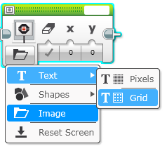
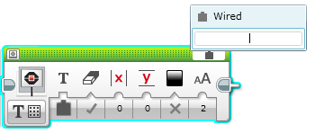
Sidebar: Display Block - Wired Mode
The Display Block can be used in wired mode to display data from another block to the screen.
For the challenge, you will need to display a number on the screen. Pick Text Mode →Grid from the bottom left corner of the block.
To pick Wired Mode, click on the top right corner of the Display Block and pick wired

Slide 8
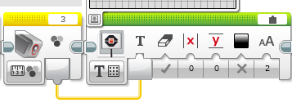
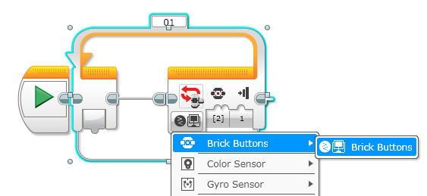
Data Wires Challenge
CHALLENGE: Make your robot drive forward slowly over different colors. Have the robot display the color the color sensor sees as it moves. Stop when you hit a button on the brick.
STEP 1: Turn the motors on in a Steering Block and drive slowly forward
STEP 2:
  Inside a Loop, add a Color Sensor block.
  Add a Display Block in Wired, Text Grid Modes.
  Wire the Sensor Block’s output into the Display Block’s
  text input (first input)
STEP 3: Exit the loop when a brick button is pressed

Slide 9
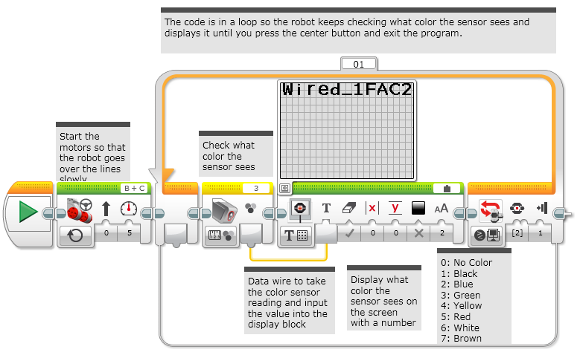
Challenge Solution

Slide 10
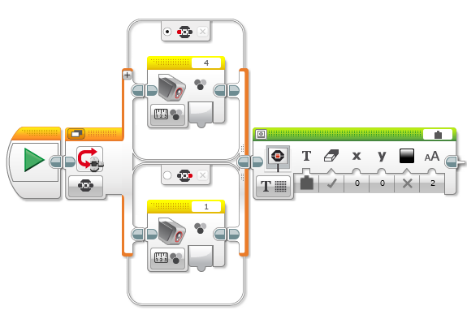
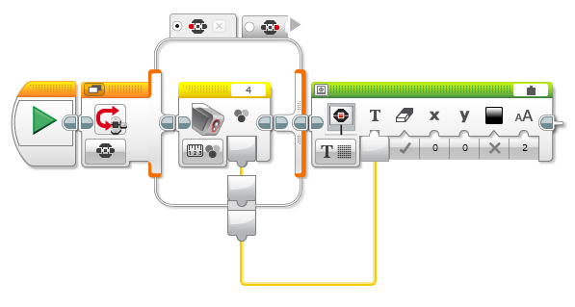
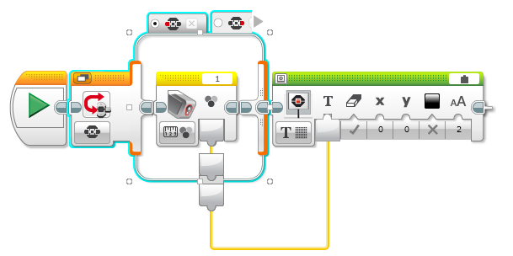
More Complex Wiring: Switches
If you want to drag data wires out of switches, you will need to change the switch to tabbed view
A
B. Once you switch to tabbed view, you can drag data wires out
C. Different options in the switch can connect to the same wire
C
C
B

Slide 11
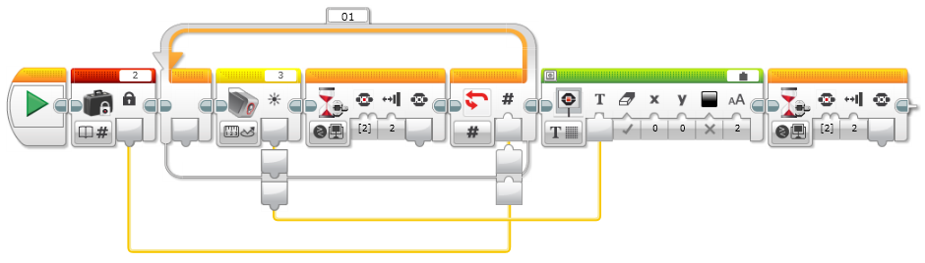
More Complex Wiring: Loops
You can connect wires both into and out of a loop like in the example below
Going into the loop
Going out the loop
Note that the data coming out of the loop through the wire will only be the last pass through the loop.
In the example above, the color sensor is read twice in the loop. However, the data wire will only have the second (and last) reading and that second reading will be displayed.

Slide 12
Credits
  This tutorial was written by Sanjay and Arvind Seshan from Droids Robotics. To contact the authors, email team@droidsrobotics.org
  More lessons at www.ev3lessons.com
This work is licensed under a Creative Commons Attribution-NonCommercial-ShareAlike 4.0 International License.

